Slide 1
Data Mining
Chapter 4: Mining Frequent Patterns, Association and Correlations:
Basic Concepts and Methods

Slide 2
Chapter 4: Mining Frequent Patterns, Association and Correlations: Basic Concepts and Methods
Basic Concepts
Frequent Itemset Mining Methods
Which Patterns Are Interesting?—Pattern Evaluation Methods
Summary

Slide 3
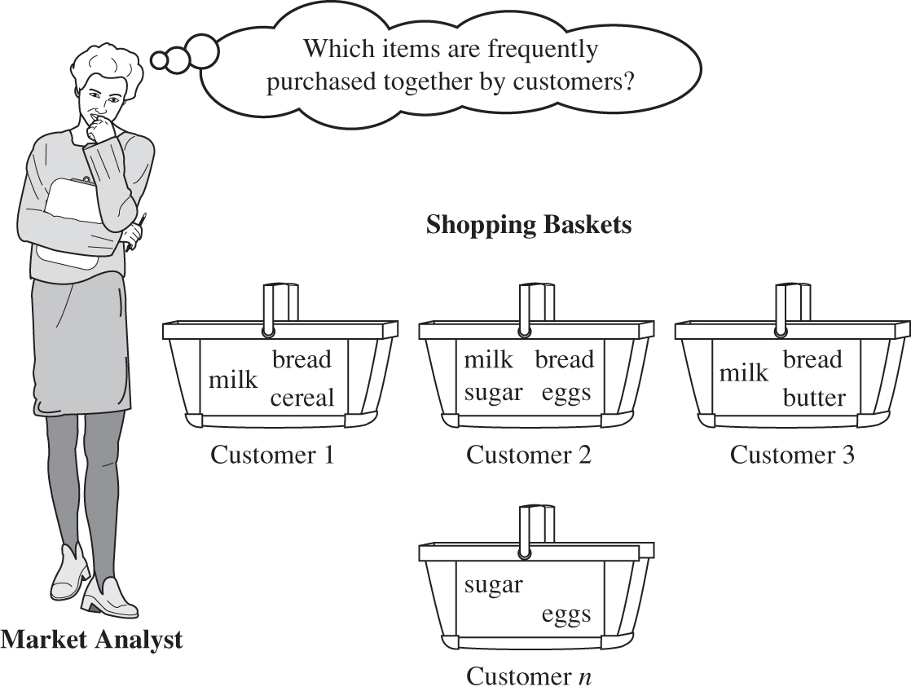

Slide 4
What Is Frequent Pattern Analysis?
Frequent pattern: a pattern (a set of items, subsequences, substructures, etc.) that occurs frequently in a data set
First proposed by Agrawal, Imielinski, and Swami [AIS93] in the context of frequent itemsets and association rule mining
Motivation: Finding inherent regularities in data
  What products were often purchased together?— Beer and diapers?!
  What are the subsequent purchases after buying a PC?
  What kinds of DNA are sensitive to this new drug?
  Can we automatically classify web documents?
Applications
  Basket data analysis, cross-marketing, catalog design, sale campaign analysis, Web log (click stream) analysis, and DNA sequence analysis.

Slide 5
Why Is Freq. Pattern Mining Important?
Freq. pattern: An intrinsic and important property of datasets
Foundation for many essential data mining tasks
  Association, correlation, and causality analysis
  Sequential, structural (e.g., sub-graph) patterns
  Pattern analysis in spatiotemporal, multimedia, time-series, and stream data
  Classification: discriminative, frequent pattern analysis
  Cluster analysis: frequent pattern-based clustering
  Data warehousing: iceberg cube and cube-gradient
  Semantic data compression: fascicles
  Broad applications

Slide 6
Basic Concepts: Frequent Patterns
Tid | Items bought
10 | Beer, Nuts, Diaper
20 | Beer, Coffee, Diaper
30 | Beer, Diaper, Eggs
40 | Nuts, Eggs, Milk
50 | Nuts, Coffee, Diaper, Eggs, Milk
itemset: A set of one or more items
k-itemset X = {x₁, …, x_{k}}
(absolute) support, or, support count of X: Frequency or occurrence of an itemset X
(relative) support, s, is the fraction of transactions that contains X (i.e., the probability that a transaction contains X)
An itemset X is frequent if X’s support is no less than a minsup threshold
Customer
buys both
Customer
buys diaper
Customer
buys beer

Slide 7
Basic Concepts: Association Rules
Find all the rules X → Y with minimum support and confidence
  support, s, probability that a transaction contains X ∪ Y
  confidence, c, conditional probability that a transaction having X also contains Y
Let minsup = 50%, minconf = 50%
Freq. Pat.: Beer:3, Nuts:3, Diaper:4, Eggs:3, {Beer, Diaper}:3
Tid
Items bought
10
Beer, Nuts, Diaper
20
Beer, Coffee, Diaper
30
Beer, Diaper, Eggs
40
Nuts, Eggs, Milk
50
Nuts, Coffee, Diaper, Eggs, Milk
Customer
buys both
Customer
buys diaper
Customer
buys beer
Association rules: (many more!)
  Beer → Diaper (60%, 100%)
  Diaper → Beer (60%, 75%)

Slide 8
Closed Patterns and Max-Patterns
A long pattern contains a combinatorial number of sub-patterns, e.g., {a₁, …, a₁₀₀} contains (₁₀₀¹) + (₁₀₀²) + … + (₁¹₀⁰₀⁰) = 2¹⁰⁰ – 1 = 1.27*10³⁰ sub-patterns!
Solution: Mine closed patterns and max-patterns instead
An itemset X is closed if X is frequent and there exists no super-pattern Y כ X, with the same support as X (proposed by Pasquier, et al. @ ICDT’99)
An itemset X is a max-pattern if X is frequent and there exists no frequent super-pattern Y כ X.
Closed pattern is a lossless compression of freq. patterns
  Reducing the # of patterns and rules

Slide 9
Closed Patterns and Max-Patterns
Exercise. DB = {<a₁, …, a₁₀₀>, < a₁, …, a₅₀>}
  Min_sup = 1.
What is the set of closed itemset?
  <a₁, …, a₁₀₀>: 1
  < a₁, …, a₅₀>: 2
What is the set of max-pattern?
  <a₁, …, a₁₀₀>: 1
What is the set of all patterns?
  !!

Slide 10
Chapter 4: Mining Frequent Patterns, Association and Correlations: Basic Concepts and Methods
Basic Concepts
Frequent Itemset Mining Methods
Which Patterns Are Interesting?—Pattern Evaluation Methods
Summary

Slide 11
Scalable Frequent Itemset Mining Methods
Apriori: A Candidate Generation-and-Test Approach
Improving the Efficiency of Apriori
FPGrowth: A Frequent Pattern-Growth Approach
ECLAT: Frequent Pattern Mining with Vertical Data Format
Mining Close Frequent Patterns and Maxpatterns

Slide 12
The Downward Closure Property and Scalable Mining Methods
The downward closure property of frequent patterns
  Any subset of a frequent itemset must be frequent
  If {beer, diaper, nuts} is frequent, so is {beer, diaper}
  i.e., every transaction having {beer, diaper, nuts} also contains {beer, diaper}
Scalable mining methods: Three major approaches
  Apriori (Agrawal & Srikant@VLDB’94)
  Freq. pattern growth (FPgrowth—Han, Pei & Yin @SIGMOD’00)
  Vertical data format approach (Charm—Zaki & Hsiao @SDM’02)

Slide 13
Apriori: A Candidate Generation & Test Approach
Apriori pruning principle: If there is any itemset which is infrequent, its superset should not be generated/tested! (Agrawal & Srikant @VLDB’94, Mannila, et al. @ KDD’ 94)
Method:
  Initially, scan DB once to get frequent 1-itemset
  Generate length (k+1) candidate itemsets from length k frequent itemsets
  Test the candidates against DB
  Terminate when no frequent or candidate set can be generated

Slide 14
The Apriori Algorithm—An Example
Sup_{min} = 2
Itemset | sup
{A} | 2
{B} | 3
{C} | 3
{D} | 1
{E} | 3
Database TDB
Itemset | sup
{A} | 2
{B} | 3
{C} | 3
{E} | 3
L₁
Tid | Items
10 | A, C, D
20 | B, C, E
30 | A, B, C, E
40 | B, E
C₁
1st scan
C₂
Itemset | sup
{A, B} | 1
{A, C} | 2
{A, E} | 1
{B, C} | 2
{B, E} | 3
{C, E} | 2
C₂
L₂
Itemset
{A, B}
{A, C}
{A, E}
{B, C}
{B, E}
{C, E}
Itemset | sup
{A, C} | 2
{B, C} | 2
{B, E} | 3
{C, E} | 2
2nd scan
C₃
Itemset
{B, C, E}
3rd scan
L₃
Itemset | sup
{B, C, E} | 2

Slide 15
The Apriori Algorithm (Pseudo-Code)
C_{k}: Candidate itemset of size k
L_{k} : frequent itemset of size k
L₁ = {frequent items};
for (k = 1; L_{k} !=∅; k++) do begin
C_{k+1} = candidates generated from L_{k};
for each transaction t in database do
  increment the count of all candidates in C_{k+1} that are contained in t
L_{k+1} = candidates in C_{k+1} with min_support
end
return ∪_{k} L_{k};

Slide 16
Implementation of Apriori
How to generate candidates?
  Step 1: self-joining L_{k}
  Step 2: pruning
Example of Candidate-generation
  L₃={abc, abd, acd, ace, bcd}
  Self-joining: L₃*L₃
    abcd from abc and abd
    acde from acd and ace
  Pruning:
    acde is removed because ade is not in L₃
  C₄ = {abcd}

Slide 17
Candidate Generation: An SQL Implementation
SQL Implementation of candidate generation
  Suppose the items in L_{k-1} are listed in an order
  Step 1: self-joining L_{k-1}
    insert into C_{k}
    select p.item₁, p.item₂, …, p.item_{k-1}, q.item_{k-1}
    from L_{k-1} p, L_{k-1} q
    where p.item₁=q.item₁, …, p.item_{k-2}=q.item_{k-2}, p.item_{k-1} < q.item_{k-1}
  Step 2: pruning
    forall itemsets c in C_{k} do
      forall (k-1)-subsets s of c do
        if (s is not in L_{k-1}) then delete c from C_{k}
Use object-relational extensions like UDFs, BLOBs, and Table functions for efficient implementation [S. Sarawagi, S. Thomas, and R. Agrawal. Integrating association rule mining with relational database systems: Alternatives and implications. SIGMOD’98]

Slide 18
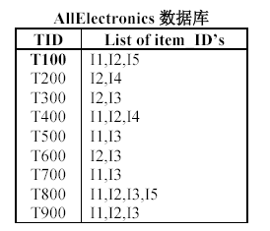
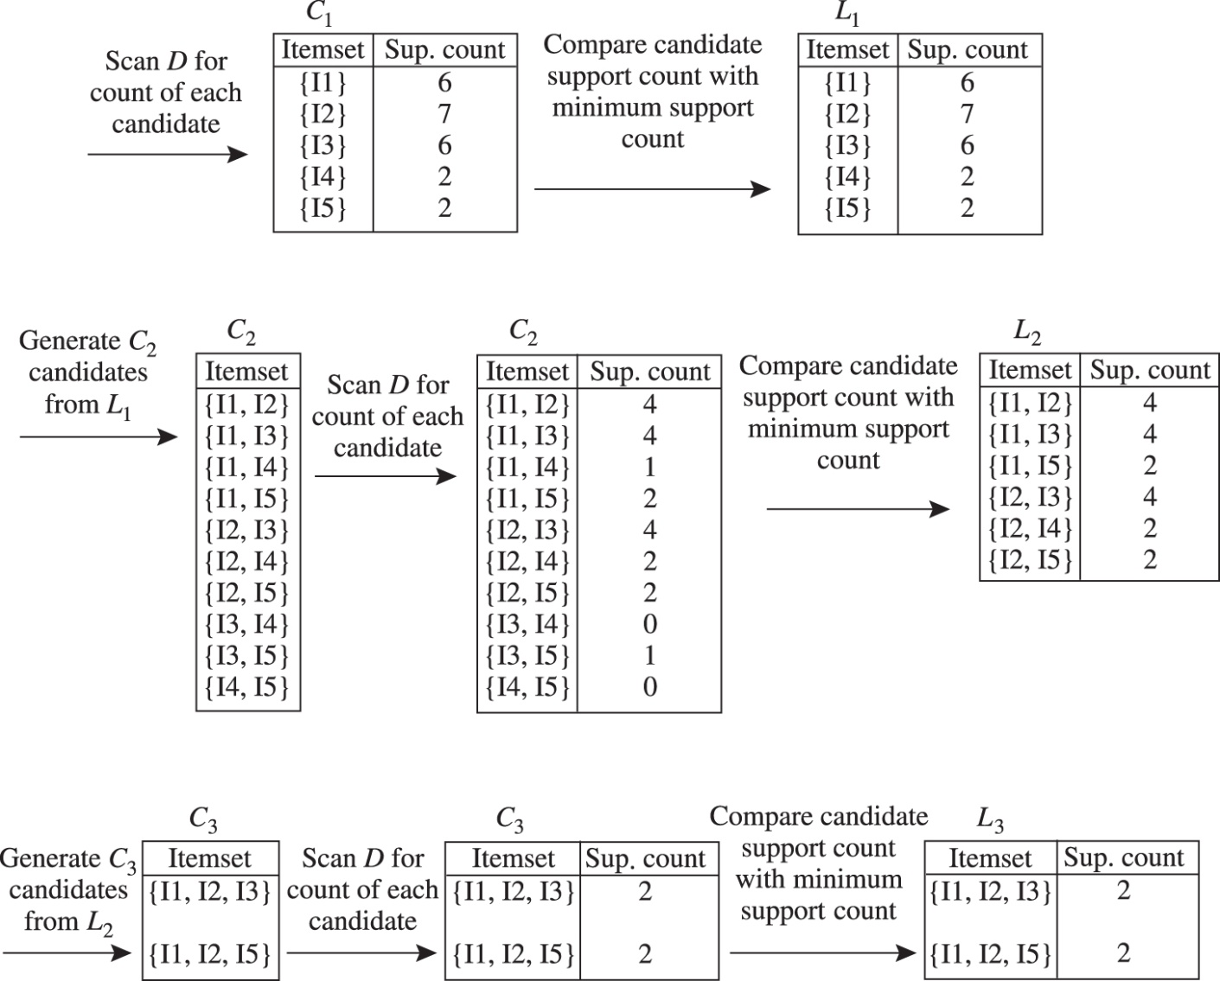
minsupport ＝ 2

Slide 19
Scalable Frequent Itemset Mining Methods
Apriori: A Candidate Generation-and-Test Approach
Improving the Efficiency of Apriori
FPGrowth: A Frequent Pattern-Growth Approach
ECLAT: Frequent Pattern Mining with Vertical Data Format
Mining Close Frequent Patterns and Maxpatterns

Slide 20
Further Improvement of the Apriori Method
Major computational challenges
  Multiple scans of transaction database
  Huge number of candidates
  Tedious workload of support counting for candidates
Improving Apriori: general ideas
  Reduce passes of transaction database scans
  Shrink number of candidates
  Facilitate support counting of candidates

Slide 21
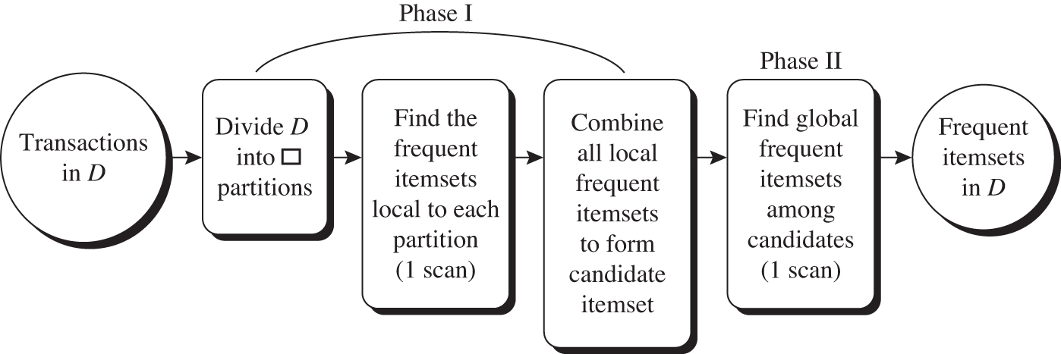
Partition: Scan Database Only Twice
Any itemset that is potentially frequent in DB must be frequent in at least one of the partitions of DB
  Scan 1: partition database and find local frequent patterns
  Scan 2: consolidate global frequent patterns
A. Savasere, E. Omiecinski and S. Navathe, VLDB’95

Slide 22
Sampling for Frequent Patterns
Select a sample of original database, mine frequent patterns within sample using Apriori
Scan database once to verify frequent itemsets found in sample, only borders of closure of frequent patterns are checked
  Example: check abcd instead of ab, ac, …, etc.
Scan database again to find missed frequent patterns
H. Toivonen. Sampling large databases for association rules. In VLDB’96

Slide 23
DIC: Reduce Number of Scans
ABCD
Once both A and D are determined frequent, the counting of AD begins
Once all length-2 subsets of BCD are determined frequent, the counting of BCD begins
ABC
ABD
ACD
BCD
AB
AC
BC
AD
BD
CD
Transactions
1-itemsets
A
B
C
D
Apriori
2-itemsets
…
{}
Itemset lattice
1-itemsets
S. Brin R. Motwani, J. Ullman, and S. Tsur. Dynamic itemset counting and implication rules for market basket data. In SIGMOD’97
2-items
DIC
3-items

Slide 24
Scalable Frequent Itemset Mining Methods
Apriori: A Candidate Generation-and-Test Approach
Improving the Efficiency of Apriori
FPGrowth: A Frequent Pattern-Growth Approach
ECLAT: Frequent Pattern Mining with Vertical Data Format
Mining Close Frequent Patterns and Maxpatterns

Slide 25
Pattern-Growth Approach: Mining Frequent Patterns Without Candidate Generation
Bottlenecks of the Apriori approach
  Breadth-first (i.e., level-wise) search
  Candidate generation and test
    Often generates a huge number of candidates
The FPGrowth Approach (J. Han, J. Pei, and Y. Yin, SIGMOD’ 00)
  Depth-first search
  Avoid explicit candidate generation
Major philosophy: Grow long patterns from short ones using local frequent items only
  “abc” is a frequent pattern
  Get all transactions having “abc”, i.e., project DB on abc: DB|abc
  “d” is a local frequent item in DB|abc → abcd is a frequent pattern

Slide 26
Construct FP-tree from a Transaction Database
TID Items bought (ordered) frequent items
100 {f, a, c, d, g, i, m, p} {f, c, a, m, p}
200 {a, b, c, f, l, m, o} {f, c, a, b, m}
300 {b, f, h, j, o, w} {f, b}
400 {b, c, k, s, p} {c, b, p}
500 {a, f, c, e, l, p, m, n} {f, c, a, m, p}
min_support = 3
{}
Header Table
Item frequency head
f 4
c 4
a 3
b 3
m 3
p 3
Scan DB once, find frequent 1-itemset (single item pattern)
Sort frequent items in frequency descending order, f-list
Scan DB again, construct FP-tree
f:4
c:1
c:3
b:1
b:1
a:3
p:1
m:2
b:1
F-list = f-c-a-b-m-p
p:2
m:1

Slide 27
Partition Patterns and Databases
Frequent patterns can be partitioned into subsets according to f-list
  F-list = f-c-a-b-m-p
  Patterns containing p
  Patterns having m but no p
  …
  Patterns having c but no a nor b, m, p
  Pattern f
Completeness and non-redundency

Slide 28
1-FS
TID | Items
1 | I1,I2,I5
2 | I2,I4
3 | I2,I3,I6
4 | I1,I2,I4
5 | I1,I3
6 | I2,I3
7 | I1,I3
8 | I1,I2,I3,I5
9 | I1,I2,I3
Itemset | Support count
{I1} | 6
{I2} | 7
{I3} | 6
{I4} | 2
{I5} | 2
{I6} | 1
Itemset | Support count
{I1} | 6
{I2} | 7
{I3} | 6
{I4} | 2
{I5} | 2
Minimum support rate: 20% (count 2)

Slide 29
FP-Tree construction
Sort by frequency descending order
Itemset | Support count
{I1} | 6
{I2} | 7
{I3} | 6
{I4} | 2
{I5} | 2
Itemset | Support count
{I2} | 7
{I1} | 6
{I3} | 6
{I4} | 2
{I5} | 2

Slide 30


FP-Tree construction
Create root node
Scan the data set
  T1: I1, I2, I5
  Sort: I2, I1, I5
I2
1
null
I1
1
I3
0
(I2,1)
Deal with the items
  Add nodes according to
  the sorted order.
  Mark the Item with its counts
I4
0
I5
1
(I1,1)
(I5,1)
Update the index list
Notes:
Header table has item, current count, and links to first node of a particular item type.

Slide 31
FP-Tree construction
TID | Items
1 | I1,I2,I5
2 | I2,I4
3 | I2,I3,I6
4 | I1,I2,I4
5 | I1,I3
6 | I2,I3
7 | I1,I3
8 | I1,I2,I3,I5
9 | I1,I2,I3
I2
2
null
I1
1
I3
0
(I2,2)
I4
1
(I1,1)
(I4,1)
I5
1
(I5,1)
Notes:
Exercise: Build the rest of the tree.

Slide 32
FP-Tree construction
TID | Items
1 | I1,I2,I5
2 | I2,I4
3 | I2,I3,I6
4 | I1,I2,I4
5 | I1,I3
6 | I2,I3
7 | I1,I3
8 | I1,I2,I3,I5
9 | I1,I2,I3
I2
3
null
I1
1
I3
1
(I2,3)
I4
1
I5
1
(I1,1)
(I3,1)
(I4,1)
(I5,1)
Notes:
Exercise: Build the rest of the tree.

Slide 33
FP-Tree construction
TID | Items
1 | I1,I2,I5
2 | I2,I4
3 | I2,I3,I6
4 | I1,I2,I4
5 | I1,I3
6 | I2,I3
7 | I1,I3
8 | I1,I2,I3,I5
9 | I1,I2,I3
I2
4
null
I1
3
I3
2
(I2,4)
I4
2
I5
1
(I1,2)
(I3,1)
(I4,1)
(I5,1)
(I4,1)
Notes:
Exercise: Build the rest of the tree.

Slide 34
FP-Tree construction
TID | Items
1 | I1,I2,I5
2 | I2,I4
3 | I2,I3,I6
4 | I1,I2,I4
5 | I1,I3
6 | I2,I3
7 | I1,I3
8 | I1,I2,I3,I5
9 | I1,I2,I3
I2
4
null
I1
3
(I1,1)
I3
2
(I2,4)
I4
2
I5
1
(I1,2)
(I3,1)
(I4,1)
(I3,1)
(I5,1)
(I4,1)
Notes:
Exercise: Build the rest of the tree.

Slide 35
FP-Tree construction
TID | Items
1 | I1,I2,I5
2 | I2,I4
3 | I2,I3,I6
4 | I1,I2,I4
5 | I1,I3
6 | I2,I3
7 | I1,I3
8 | I1,I2,I3,I5
9 | I1,I2,I3
I2
7
null
I1
6
(I1,2)
I3
6
(I2,7)
I4
2
I5
2
(I1,4)
(I3,2)
(I4,1)
(I3,2)
(I5,1)
(I3,2)
(I4,1)
(I5,1)
Notes:
Exercise: Build the rest of the tree.

Slide 36
FP-Tree construction
Insert_Tree([p|P],T)
If T has a child N such that N.item-name=
p.item-name,
then increment N’s count by 1;
else create a new node N, and let its count be 1,
its parent link be linked to T, and its node-
link to the nodes with the same item-name
via the node-link structure.
If P is nonempty, call insert_tree(P,N) recursively.

Slide 37
Mining FP-Tree
Cond. pattern base
  (I2 I1,1)
  (I2 I1 I3, 1)
Cond. Path
  (I2 I1, 2)
(I2 I1 I5, 2),
(I2 I5, 2),
(I1 I5, 2)
For I5
I2
7
null
I1
6
(I1,2)
I3
6
(I2,7)
null
I4
2
(I3,2)
(I1,4)
(I4,1)
I5
2
(I3,2)
(I2,2)
(I5,1)
(I4,1)
(I3,2)
(I1,2)
(I5,1)
Notes:
Exercise: What other frequent patterns come from the CP tree?
Exercise: Mine all frequent patterns.

Slide 38
Mining FP-Tree
Item | Cond. pattern base | Cond. FP-tree | FP
I5 | {(I2 I1:1),(I2 I1 I3:1)} | <I2:2,I1:2> | I2 I5:2, I1 I5:2, I2 I1 I5:2
I4 | {(I2 I1:1),(I2:1)} | <I2:2> | I2 I4:2
I3 | {(I2 I1:2,(I2:2),(I1:2)} | <I2:4,I1:2>, <I1:2> | I2 I3:4, I1 I3:2, I2 I1 I3:2
I1 | {(I2:4)} | <I2:4> | I2 I1:4
Notes:
Exercise: Build the rest of the tree.

Slide 39
Benefits of the FP-tree Structure
Completeness
  Preserve complete information for frequent pattern mining
  Never break a long pattern of any transaction
Compactness
  Reduce irrelevant info—infrequent items are gone
  Items in frequency descending order: the more frequently occurring, the more likely to be shared
  Never be larger than the original database (not count node-links and the count field)

Slide 40
The Frequent Pattern Growth Mining Method
Idea: Frequent pattern growth
  Recursively grow frequent patterns by pattern and database partition
Method
  For each frequent item, construct its conditional pattern-base, and then its conditional FP-tree
  Repeat the process on each newly created conditional FP-tree
  Until the resulting FP-tree is empty, or it contains only one path—single path will generate all the combinations of its sub-paths, each of which is a frequent pattern

Slide 41
Scaling FP-growth by Database Projection
What about if FP-tree cannot fit in memory?
  DB projection
First partition a database into a set of projected DBs
Then construct and mine FP-tree for each projected DB
Parallel projection vs. partition projection techniques
  Parallel projection
    Project the DB in parallel for each frequent item
    Parallel projection is space costly
    All the partitions can be processed in parallel
  Partition projection
    Partition the DB based on the ordered frequent items
    Passing the unprocessed parts to the subsequent partitions

Slide 42
Partition-Based Projection
Parallel projection needs a lot of disk space
Partition projection saves it
Tran. DB
fcamp
fcabm
fb
cbp
fcamp
p-proj DB
fcam
cb
fcam
m-proj DB
fcab
fca
fca
b-proj DB
f
c
…
a-proj DB
fc
…
c-proj DB
f
…
f-proj DB
…
am-proj DB
fc
fc
fc
cm-proj DB
f
f
f
…

Slide 43

FP-Growth vs. Apriori: Scalability With the Support Threshold
Data set T25I20D10K

Slide 44
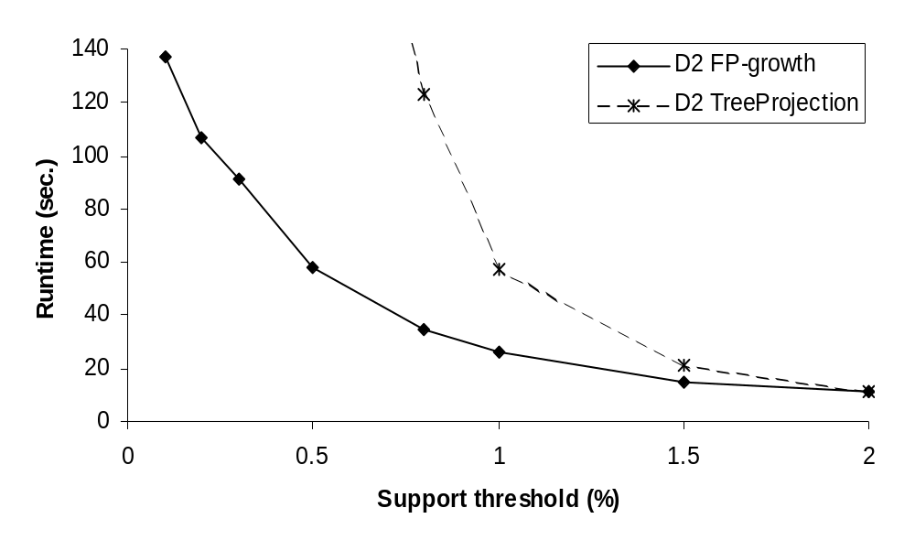
FP-Growth vs. Tree-Projection: Scalability with the Support Threshold
Data set T25I20D100K
Data Mining: Concepts and Techniques

Slide 45
Advantages of the Pattern Growth Approach
Divide-and-conquer:
  Decompose both the mining task and DB according to the frequent patterns obtained so far
  Lead to focused search of smaller databases
Other factors
  No candidate generation, no candidate test
  Compressed database: FP-tree structure
  No repeated scan of entire database
  Basic ops: counting local freq items and building sub FP-tree, no pattern search and matching
A good open-source implementation and refinement of FPGrowth
  FPGrowth+ (Grahne and J. Zhu, FIMI'03)

Slide 46
Further Improvements of Mining Methods
AFOPT (Liu, et al. @ KDD’03)
  A “push-right” method for mining condensed frequent pattern (CFP) tree
Carpenter (Pan, et al. @ KDD’03)
  Mine data sets with small rows but numerous columns
  Construct a row-enumeration tree for efficient mining
FPgrowth+ (Grahne and Zhu, FIMI’03)
  Efficiently Using Prefix-Trees in Mining Frequent Itemsets, Proc. ICDM'03 Int. Workshop on Frequent Itemset Mining Implementations (FIMI'03), Melbourne, FL, Nov. 2003
TD-Close (Liu, et al, SDM’06)

Slide 47
Extension of Pattern Growth Mining Methodology
Mining closed frequent itemsets and max-patterns
  CLOSET (DMKD’00), FPclose, and FPMax (Grahne & Zhu, Fimi’03)
Mining sequential patterns
  PrefixSpan (ICDE’01), CloSpan (SDM’03), BIDE (ICDE’04)
Mining graph patterns
  gSpan (ICDM’02), CloseGraph (KDD’03)
Constraint-based mining of frequent patterns
  Convertible constraints (ICDE’01), gPrune (PAKDD’03)
Computing iceberg data cubes with complex measures
  H-tree, H-cubing, and Star-cubing (SIGMOD’01, VLDB’03)
Pattern-growth-based Clustering
  MaPle (Pei, et al., ICDM’03)
Pattern-Growth-Based Classification
  Mining frequent and discriminative patterns (Cheng, et al, ICDE’07)

Slide 48
Scalable Frequent Itemset Mining Methods
Apriori: A Candidate Generation-and-Test Approach
Improving the Efficiency of Apriori
FPGrowth: A Frequent Pattern-Growth Approach
ECLAT: Frequent Pattern Mining with Vertical Data Format
Mining Close Frequent Patterns and Maxpatterns

Slide 49
ECLAT: Mining by Exploring Vertical Data Format
Vertical format: t(AB) = {T₁₁, T₂₅, …}
  tid-list: list of trans.-ids containing an itemset
Deriving frequent patterns based on vertical intersections
  t(X) = t(Y): X and Y always happen together
  t(X) ⊂ t(Y): transaction having X always has Y
Using diffset to accelerate mining
  Only keep track of differences of tids
  t(X) = {T₁, T₂, T₃}, t(XY) = {T₁, T₃}
  Diffset (XY, X) = {T₂}
Eclat (Zaki et al. @KDD’97)
Mining Closed patterns using vertical format: CHARM (Zaki & Hsiao@SDM’02)

Slide 50
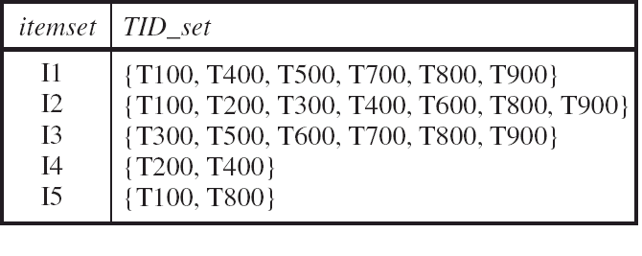
Vertical Data Transformation
Horizontal: Trans.-Item
Vertical: Trans.-Item
  One scan transformation

Slide 51
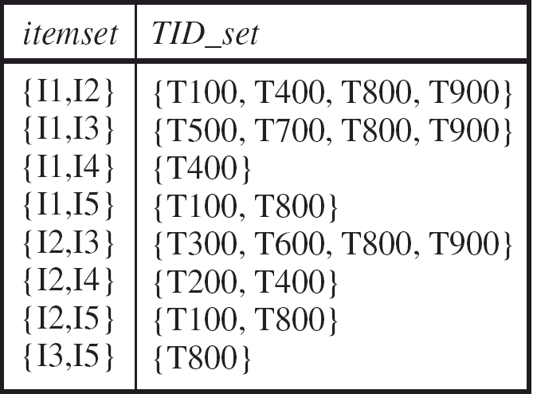
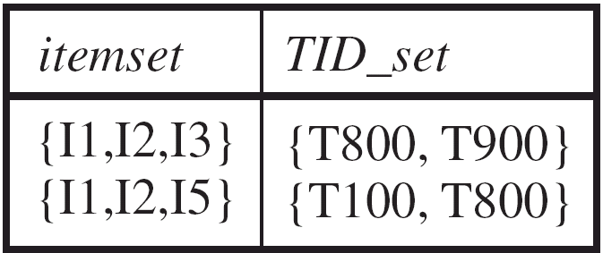
Using Apriori to mine data;
Calculate the intersection between item pairs.

Slide 52
Scalable Frequent Itemset Mining Methods
Apriori: A Candidate Generation-and-Test Approach
Improving the Efficiency of Apriori
FPGrowth: A Frequent Pattern-Growth Approach
ECLAT: Frequent Pattern Mining with Vertical Data Format
Mining Close Frequent Patterns and Maxpatterns

Slide 53
Mining Frequent Closed Patterns: CLOSET
Flist: list of all frequent items in support ascending order
  Flist: d-a-f-e-c
Divide search space
  Patterns having d
  Patterns having d but no a, etc.
Find frequent closed pattern recursively
  Every transaction having d also has cfa → cfad is a frequent closed pattern
J. Pei, J. Han & R. Mao. “CLOSET: An Efficient Algorithm for Mining Frequent Closed Itemsets", DMKD'00.
Min_sup=2
TID | Items
10 | a, c, d, e, f
20 | a, b, e
30 | c, e, f
40 | a, c, d, f
50 | c, e, f

Slide 54
CLOSET+: Mining Closed Itemsets by Pattern-Growth
Itemset merging: if Y appears in every occurrence of X, then Y is merged with X
Sub-itemset pruning: if Y כ X, and sup(X) = sup(Y), X and all of X’s descendants in the set enumeration tree can be pruned
Hybrid tree projection
  Bottom-up physical tree-projection
  Top-down pseudo tree-projection
Item skipping: if a local frequent item has the same support in several header tables at different levels, one can prune it from the header table at higher levels
Efficient subset checking

Slide 55
MaxMiner: Mining Max-Patterns
1st scan: find frequent items
  A, B, C, D, E
2nd scan: find support for
  AB, AC, AD, AE, ABCDE
  BC, BD, BE, BCDE
  CD, CE, CDE, DE
Since BCDE is a max-pattern, no need to check BCD, BDE, CDE in later scan
R. Bayardo. Efficiently mining long patterns from databases. SIGMOD’98
Tid | Items
10 | A, B, C, D, E
20 | B, C, D, E,
30 | A, C, D, F
Potential max-patterns

Slide 56
CHARM: Mining by Exploring Vertical Data Format
Vertical format: t(AB) = {T₁₁, T₂₅, …}
  tid-list: list of trans.-ids containing an itemset
Deriving closed patterns based on vertical intersections
  t(X) = t(Y): X and Y always happen together
  t(X) ⊂ t(Y): transaction having X always has Y
Using diffset to accelerate mining
  Only keep track of differences of tids
  t(X) = {T₁, T₂, T₃}, t(XY) = {T₁, T₃}
  Diffset (XY, X) = {T₂}
Eclat/MaxEclat (Zaki et al. @KDD’97), VIPER(P. Shenoy et al.@SIGMOD’00), CHARM (Zaki & Hsiao@SDM’02)

Slide 57
Chapter 5: Mining Frequent Patterns, Association and Correlations: Basic Concepts and Methods
Basic Concepts
Frequent Itemset Mining Methods
Which Patterns Are Interesting?—Pattern Evaluation Methods
Summary

Slide 58



Interestingness Measure: Correlations (Lift)
play basketball ⇒ eat cereal [40%, 66.7%] is misleading
  The overall % of students eating cereal is 75% > 66.7%.
play basketball ⇒ not eat cereal [20%, 33.3%] is more accurate, although with lower support and confidence
Measure of dependent/correlated events: lift
 | Basketball | Not basketball | Sum (row)
Cereal | 2000 | 1750 | 3750
Not cereal | 1000 | 250 | 1250
Sum(col.) | 3000 | 2000 | 5000

Slide 59

Are lift and χ² Good Measures of Correlation?
“Buy walnuts ⇒ buy milk [1%, 80%]” is misleading if 85% of customers buy milk
Support and confidence are not good to indicate correlations
Over 20 interestingness measures have been proposed (see Tan, Kumar, Sritastava @KDD’02)
Which are good ones?

Slide 60

Null-Invariant Measures

Slide 61


Comparison of Interestingness Measures
Null-(transaction) invariance is crucial for correlation analysis
Lift and χ² are not null-invariant
5 null-invariant measures
 | Milk | No Milk | Sum (row)
Coffee | m, c | ~m, c | c
No Coffee | m, ~c | ~m, ~c | ~c
Sum(col.) | m | ~m | Σ
Null-transactions w.r.t. m and c
Kulczynski measure (1927)
Null-invariant
Data Mining: Concepts and Techniques
Subtle: They disagree

Slide 62

Analysis of DBLP Coauthor Relationships
Recent DB conferences, removing balanced associations, low sup, etc.
Advisor-advisee relation: Kulc: high, coherence: low, cosine: middle
Tianyi Wu, Yuguo Chen and Jiawei Han, “Association Mining in Large Databases: A Re-Examination of Its Measures”, Proc. 2007 Int. Conf. Principles and Practice of Knowledge Discovery in Databases (PKDD'07), Sept. 2007

Slide 63


Which Null-Invariant Measure Is Better?
IR (Imbalance Ratio): measure the imbalance of two itemsets A and B in rule implications
Kulczynski and Imbalance Ratio (IR) together present a clear picture for all the three datasets D₄ through D₆
  D₄ is balanced & neutral
  D₅ is imbalanced & neutral
  D₆ is very imbalanced & neutral

Slide 64
Chapter 5: Mining Frequent Patterns, Association and Correlations: Basic Concepts and Methods
Basic Concepts
Frequent Itemset Mining Methods
Which Patterns Are Interesting?—Pattern Evaluation Methods
Summary

Slide 65
Summary
Basic concepts: association rules, support-confident framework, closed and max-patterns
Scalable frequent pattern mining methods
  Apriori (Candidate generation & test)
  Projection-based (FPgrowth, CLOSET+, ...)
  Vertical format approach (ECLAT, CHARM, ...)
Which patterns are interesting?
  Pattern evaluation methods

